Slide 1
Topic
Proposer:
Date: Feb 02, 2022

Slide 2
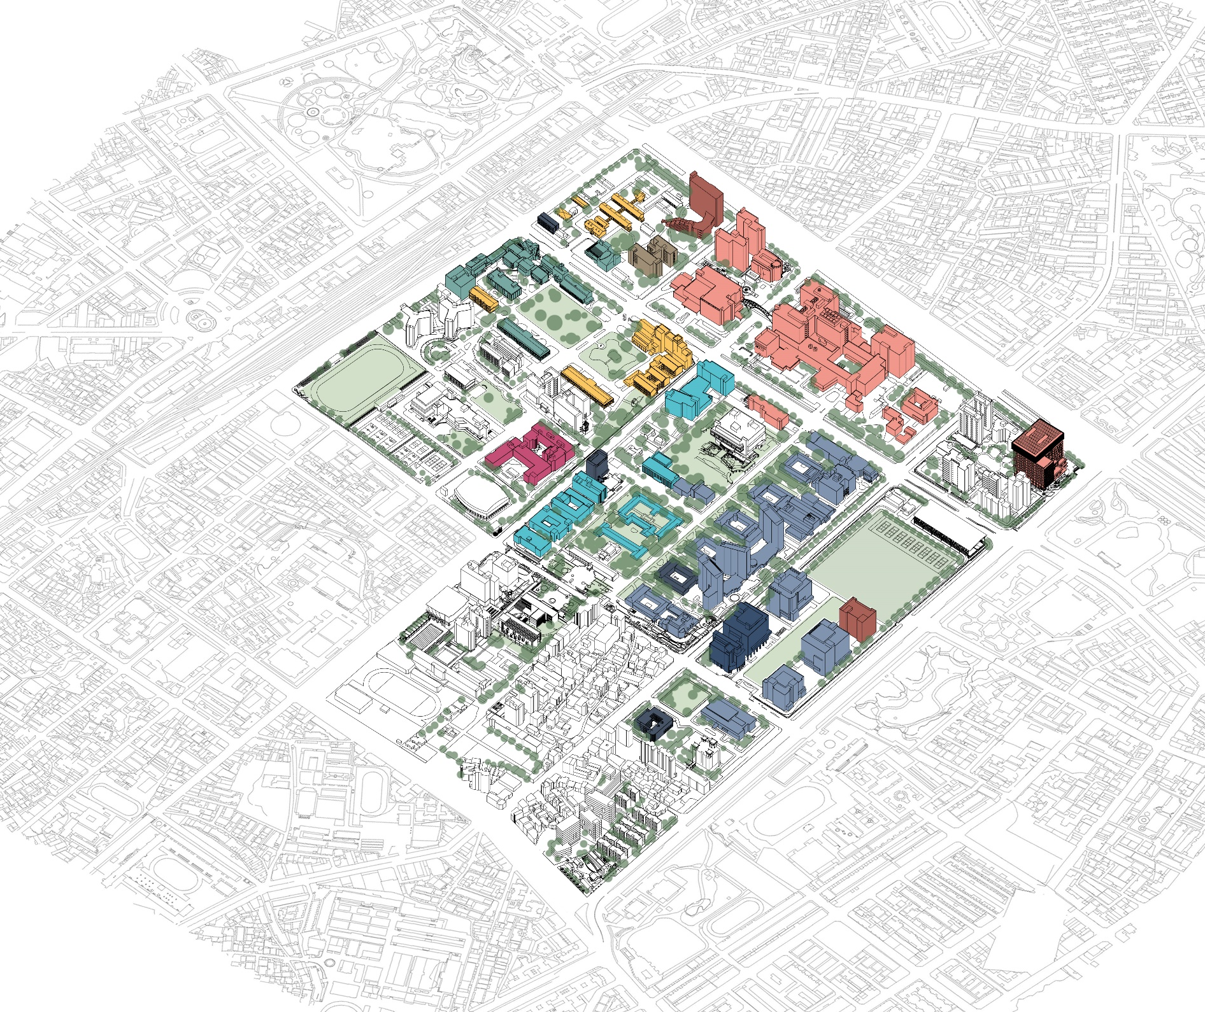
Topic
(Figure Here)
Proposer:
Date: Feb 02, 2022

Slide 3
Type Title Text Here

Slide 4
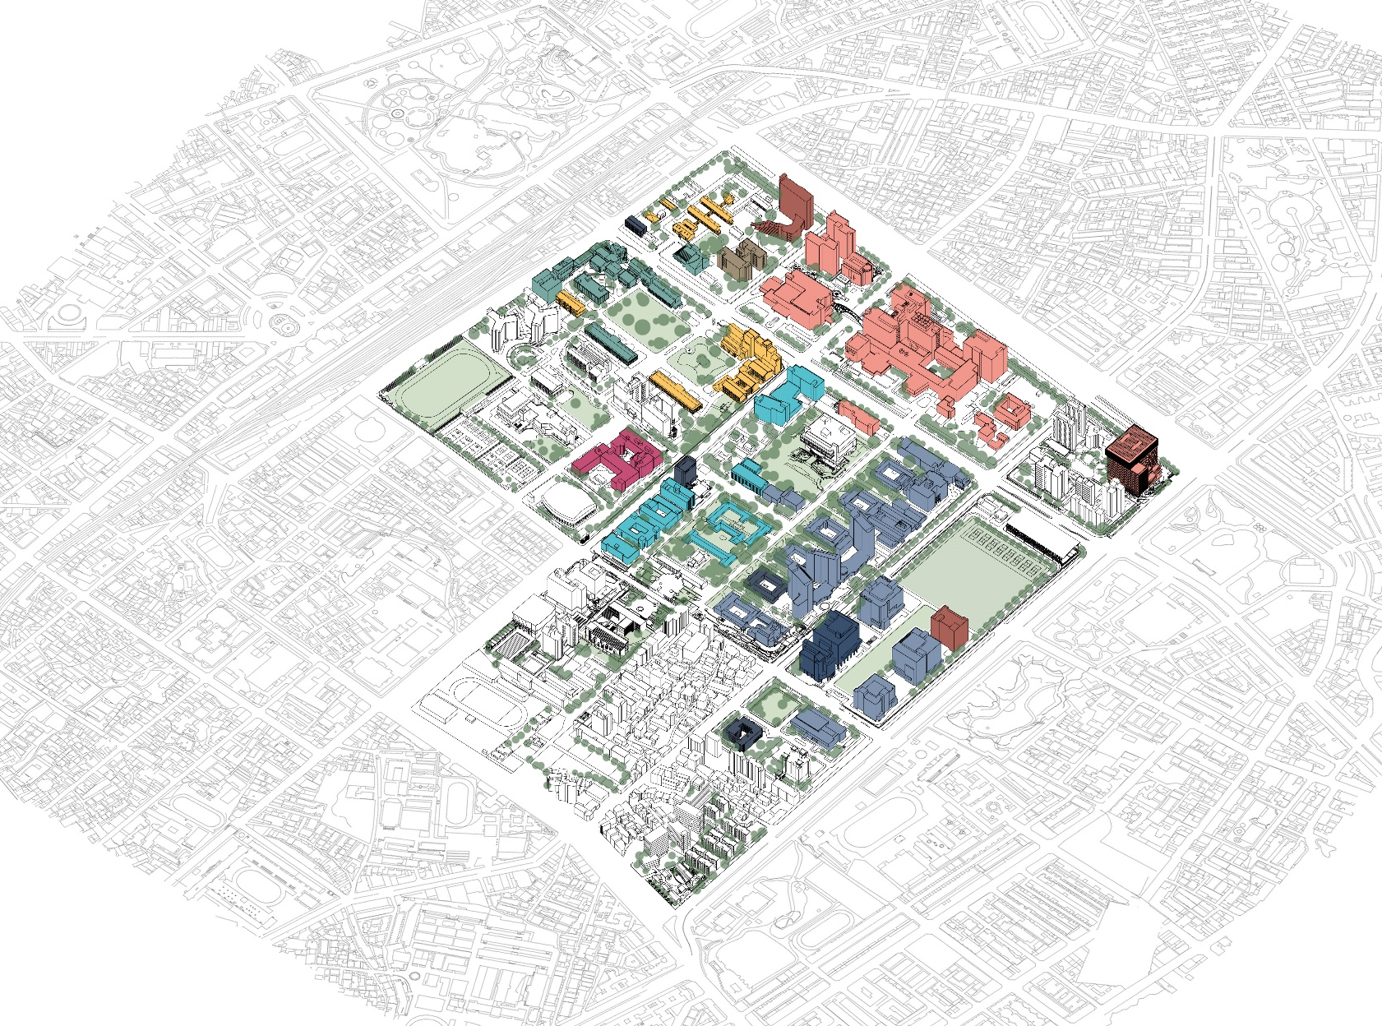
Type Title Text Here
(Figure Here)

Slide 5
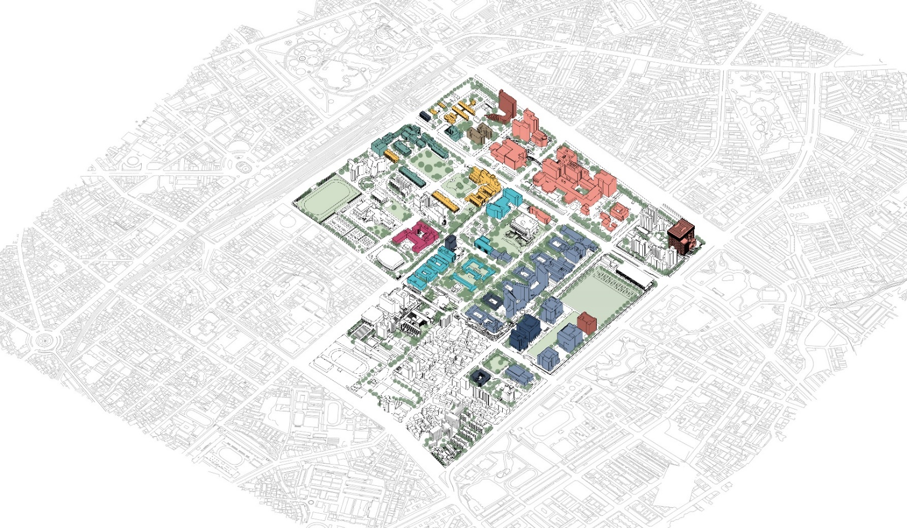
Type Title Text Here
Subtitle(Arial/24pt)
Item 1 (Arial/18pt)
Item 2
Item 3
Item 4
Item 5
Item 6

Slide 6
Type Title Text Here
Subtitle(Arial/24pt)
Content Text (Arial/14pt):
In academic publishing, a paper is an academic work that is usually published in an academic journal. It contains original research results or reviews existing results. Such a paper, also called an article, will only be considered valid if it undergoes a process of peer review by one or more referees (who are academics in the same field) who check that the content of the paper is suitable for publication in the journal.
This is particularly true for the most popular journals where the number of accepted articles often outnumbers the space for printing. Due to this, many academics self-archive a 'preprint' or 'postprint' copy of their paper for free download from their personal or institutional website.

Slide 7
Type Title Text Here
Subtitle(Arial/24pt)
Content Text (Arial/14pt):
In academic publishing, a paper is an academic work that is usually published in an academic journal. It contains original research results or reviews existing results. Such a paper, also called an article, will only be considered valid if it undergoes a process of peer review by one or more referees (who are academics in the same field) who check that the content of the paper is suitable for publication in the journal.
This is particularly true for the most popular journals where the number of accepted articles often outnumbers the space for printing. Due to this, many academics self-archive a 'preprint' or 'postprint' copy of their paper for free download from their personal or institutional website.

Slide 8

Type Title Text Here
Subtitle(Arial/24pt)
Content Text (Arial/14pt):
In academic publishing, a paper is an academic work that is usually published in an academic journal.
This is particularly true for the most popular journals where the number of accepted articles often outnumbers the space for printing. Due to this, many academics self-archive a 'preprint' or 'postprint' copy of their paper for free download from their personal or institutional website.
(Figure Here)
Figure note (Arial/9pt)

Slide 9
Subtitle(Arial/24pt)
Content Text (Arial/14pt):
In academic publishing, a paper is an academic work that is usually published in an academic journal. It contains original research results or reviews existing results. Such a paper, also called an article, will only be considered valid if it undergoes a process of peer review by one or more referees (who are academics in the same field) who check that the content of the paper is suitable for publication in the journal. A paper may undergo a series of reviews, revisions, and re-submissions before finally being accepted or rejected for publication. This process typically takes several months. Next, there is often a delay of many months (or in some fields, over a year) before an accepted manuscript appears.
Some journals, particularly newer ones, are now published in electronic form only. Paper journals are now generally made available in electronic form as well, both to individual subscribers, and to libraries. Almost always these electronic versions are available to subscribers immediately upon publication of the paper version, or even before; sometimes they are also made available to non-subscribers, either immediately (by open access journals) or after an embargo of anywhere from two to twenty-four months or more, in order to protect against loss of subscriptions.

Slide 10
Subtitle(Arial/24pt)
Item 1 (Arial/20pt)
Item 2
Item 3
Item 4
Item 5
Item 6

Slide 11

(Figure Here)
Subtitle(Arial/24pt)
Content Text (Arial/14pt):
In academic publishing, a paper is an academic work that is usually published in an academic journal.
This is particularly true for the most popular journals where the number of accepted articles often outnumbers the space for printing. Due to this, many academics self-archive a 'preprint' or 'postprint' copy of their paper for free download from their personal or institutional website.
Figure note (Arial/9pt)

Slide 12

(Figure Here)
Subtitle(Arial/24pt)
Item 1 (Arial/20pt)
Item 2
Item 3
Item 4
Item 5
Item 6
Figure note (Arial/9pt)

Slide 13

(Figure Here)
Subtitle(Arial/24pt)
Content Text (Arial/14pt):
In academic publishing, a paper is an academic work that is usually published in an academic journal. It contains original research results or reviews existing results. Such a paper, also called an article, will only be considered valid if it undergoes a process of peer review by one or more referees (who are academics in the same field) who check that the content of the paper is suitable for publication in the journal.
This is particularly true for the most popular journals where the number of accepted articles often outnumbers the space for printing. Due to this, many academics self-archive a 'preprint' or 'postprint' copy of their paper for free download from their personal or institutional website.
Figure note (Arial/9pt)

Slide 14
Subtitle(Arial/24pt)
Content Text (Arial/14pt):
In academic publishing, a paper is an academic work that is usually published in an academic journal. It contains original research results or reviews existing results. Such a paper, also called an article, will only be considered valid if it undergoes a process of peer review by one or more referees (who are academics in the same field) who check that the content of the paper is suitable for publication in the journal.
This is particularly true for the most popular journals where the number of accepted articles often outnumbers the space for printing. Due to this, many academics self-archive a 'preprint' or 'postprint' copy of their paper for free download from their personal or institutional website.
Content Text (Arial/14pt):
In academic publishing, a paper is an academic work that is usually published in an academic journal. It contains original research results or reviews existing results. Such a paper, also called an article, will only be considered valid if it undergoes a process of peer review by one or more referees (who are academics in the same field) who check that the content of the paper is suitable for publication in the journal.
This is particularly true for the most popular journals where the number of accepted articles often outnumbers the space for printing. Due to this, many academics self-archive a 'preprint' or 'postprint' copy of their paper for free download from their personal or institutional website.

Slide 15
Subtitle(Arial/24pt)
Item 1 (Arial/20pt)
Item 2
Item 3
Item 4
Item 5
Item 6
Content Text (Arial/14pt):
In academic publishing, a paper is an academic work that is usually published in an academic journal. It contains original research results or reviews existing results. Such a paper, also called an article, will only be considered valid if it undergoes a process of peer review by one or more referees (who are academics in the same field) who check that the content of the paper is suitable for publication in the journal.
This is particularly true for the most popular journals where the number of accepted articles often outnumbers the space for printing. Due to this, many academics self-archive a 'preprint' or 'postprint' copy of their paper for free download from their personal or institutional website.

